Slide 1

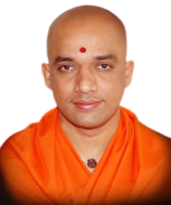


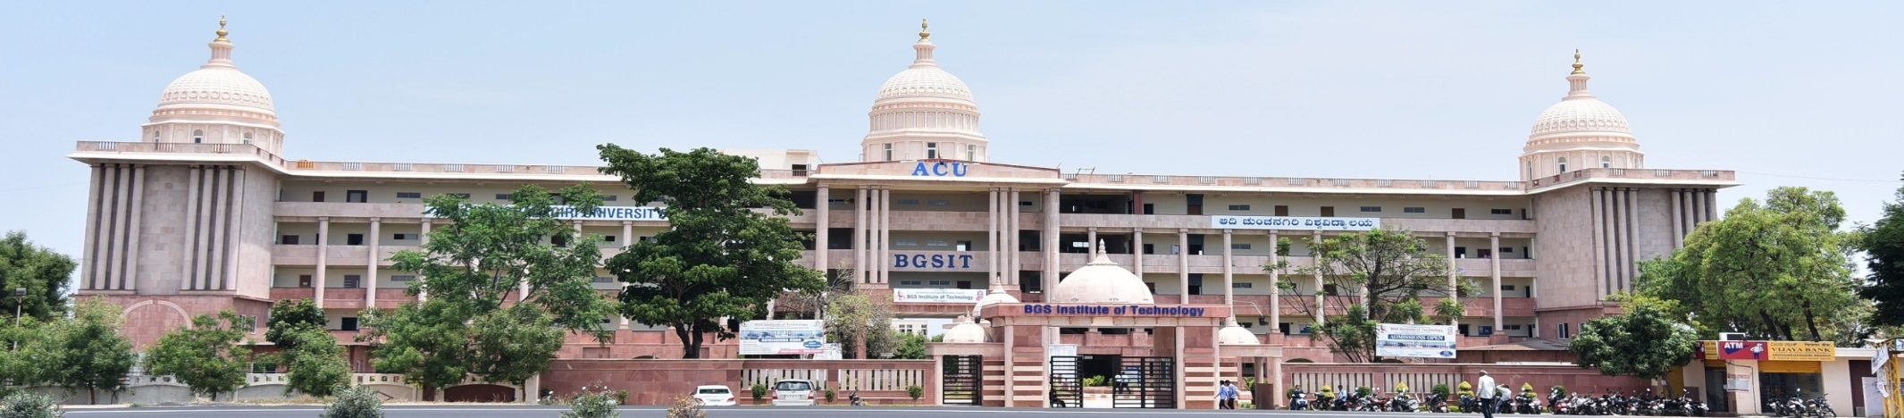
BGS Institute of Technology
|| Jai Sri Gurudev||
BG Nagara – 571448, Nagamangala Taluk, Mandya District
Department of Electronics and Communication Engineering
Welcome
to
NBA Committee Members
24-09-2021
Department of Electronics and Communication Engineering
1

Slide 2

Agenda
Introduction
Department Achievements
Criterion 1 Vision, Mission and PEOs
Criterion 2 Program Curriculum and Teaching-Learning Processes
Criterion 3 Program Outcomes and Course Outcomes
Criterion 4 Students Performance
Criterion 5 Faculty Information and Contributions
Criterion 6 Facilities and Technical Support
Criterion 7 Continuous Improvement
OBE Philosophy of the Department
Conclusion
Department of Electronics and Communication Engineering
1

Slide 3
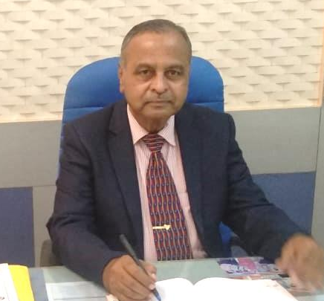
Head of the Department
Dr. K N Muralidhara _{M.E, Ph.D (IITR)}
Professor & Head
Department of Electronics and Communication Engineering
Ph.D, Electronics Devices and Computer Simulation, IIT Roorkee - 1998
M.E – solid state Electronics, IIT Roorkee - 1990
B.E – Electronics and Communication Engineering, University of Mysore - 1980
Ph.D. Students-Guiding: VTU, Belagavi – 2 Nos.
Guided: VTU, Belagavi-4 Nos.
UOM, Mysuru-1 No.
Experience: Teaching Experience – 40 Years
Research Experience – 17 Years
Other Information & Experience:
BOE Member, VTU Belagavi
BOS Member, RVCE Bangalore
BOS Member, UVCE Bangalore
BOS Member, Dr. AIT Bangalore
Regional Coordinator-VTU Examination
Interview Committee Members of Colleges
HOD of ECE –PESCE Mandya
NBA Trainer
Research Papers: International Journal – 36
International Conference – 20
National Conference- 13
Memberships of Professional Bodies:
IETE-Life Member(Fellow)
ISTE-Life Member
Department of Electronics and Communication Engineering

Slide 4
Introduction
Start of B.E( E& C) Programme | 2005-06
Sanctioned Students Intake | 60
Present Students Intake | 120 (Increased – AY: 2007-08)
Present Faculty Cadre Ratio (Prof : Assoc. Prof : Asst. Prof) | Prof: 3 Assoc. Prof: 2 Asst. Prof : 23
Avg Students- Faculty Ratio (3 Years) | 1:19
Present Faculty with Qualification | Ph.D. – 05, M.Tech. – 23 ; Total – 28
Present Technical & Support Staff | Foreman(BE) - 01, Instructors(BE, Diploma)- 06, Assistant Electrician(SSLC)- 01, Assistant Instructor(ITI) – 01, Attender(SSLC)- 01, Peon- 02 ; Total - 12
Start of M.Tech Program | 2010-11 (VLSI Design and Embedded Systems )
Research Guides/Supervisors (For Ph.D. programme) | 04
Department of Electronics and Communication Engineering

Slide 5
Introduction(Contd..)
Approved Research Centres | Visveswaraya Technological University(VTU) Belagavi ,Karnataka Adichunchanagiri University(ACU), BG Nagara, Karnataka
Research Scholars pursuing Ph.D. program | VTU – 04, ACU – 11 ; Total - 15
Laboratory Halls | 10
Class Rooms | 08
Department Library | Volumes: 1147, Titles: 277, Conference Proceedings: 07, Project Reports(BE, Mtech): 350
Seminar Hall | 200 Seat Capacity, AC Units, CCTV, LCD Projector, Audio Visual system, Wifi, Internet.
Faculty Rooms | 11
Placements | Average of three years(2019-20, 2018-19, 2017-18) : 60%
Internet | 500 MBPS with Wi-fi facility
Department of Electronics and Communication Engineering

Slide 6







Department Achievements/ Recognitions
Average Enrolment ratio for three academic years 96.41%.
Successive graduation rate 83%.
Average Placement Records for three years 60%.
Average Professional Experience of Faculties is 10+ years. 57%
Retention of Faculties 88%.
Research Scholars pursuing Ph.D in BGS R&D Centre, ECE Dept. 15
Student Chapter and Forum
IEEE, Circuit And System (CAS)Chapter
IETE Student forum.
Professional Membership Bodies
Faculty have membership in
IEEE (Members - 19 ), Senior Members-03
Indian Science Congress (Life Members -17)
ISTE ( Life Members - 23 )
IEI (Life Members – 22)
IEAE (Life Members – 2)
IETE
Department of Electronics and Communication Engineering

Slide 7
Department Achievements/ Recognitions (Department Level)
Sl.No | Year | Scheme | Sponsored Agency | Amount
1 | 2020 | ACU Grants | Adichunchanagiri University | Rs. 3.40 Lakhs
2 | 2020 | Student projects | KSCST, Govt. of Karnataka | Rs. 0.24 Lakhs
3 | 2019 | EAC | DST-EDII Gujarat | Rs. 1.40 Lakhs
4 | 2019 | Student projects | KSCST, Govt. of Karnataka | Rs. 0.075 Lakhs
5 | 2018 | FDP | VGST, Govt. of Karnataka | Rs. 2.00 Lakhs
6 | 2018 | Student projects | KSCST, Govt. of Karnataka | Rs. 0.12 Lakhs
7 | 2013 | SDP | VGST, Govt. of Karnataka | Rs. 25.00 Lakhs
8 | 2012 | FDP | VGST, Govt. of Karnataka | Rs. 2.00 Lakhs
9 | 2012 | CESEM | VGST, Govt. of Karnataka | Rs. 40.00 Lakhs
10 | 2010 | K-FIST L1 | VGST, Govt. of Karnataka | Rs. 20.00 Lakhs
11 | 2020 | NAIN | Govt. of Karnataka | (Nearly 2.4 Crore)
Total Amount |  |  |  | Rs. 94.235 Lakhs
Department of Electronics and Communication Engineering

Slide 8
Department Achievements/ Recognitions (Faculty Level)
Research Grants Received
Ph.D Awardees (Faculty)
Sl.No | Faculty Name | Total Grants Received
1 | Dr. M.B Anandaraju | 60 Lakh
2 | Dr. Naveen K B | 4.8 Lakh
Sl.No | Faculty Name | Year | University
1 | Dr. Manjunath R C | 2017 | Jain University, Bengaluru
2 | Dr. Naveen K B | 2018 | VTU, Belagavi
3 | Dr. Manoj Kumar S B | 2021 | Mysore University
Sl.No | Best Teacher Award | Year
1 | Mr. Naveen K B | 2017
2 | Mrs. Prabhavathi K | 2017
3 | Mr. Nandeesh M | 2017
4 | Ms. Anusha M N | 2017
5 | Mrs. Kavitha B C | 2018
6 | Mrs. Shalini K J | 2018
7 | Mr. Manoj Kumar S B | 2018
8 | Mr. Mohan Kumar K S | 2018
9 | Mr. Balaji B S | 2019
10 | Mrs. Nandini S | 2019
11 | Mr. Puneeth Kumar G B | 2019
Sl.No | Patents | No.
1 | Filed | 09
Sl. No | Research Publications (CAY, CAYm1, CAYm2, CAYm3) (2020-21, 2019-20, 2018-19, 2017-18) | No.
1 | Reputed Journals (Scopus Indexed, UGC Care List etc.,) | 20
2 | Other Journals (IRJET, JAERD,IRJMET & IRJEMET etc.,) | 120
3 | Conference | 7
Department of Electronics and Communication Engineering

Slide 9
Department Achievements/ Recognitions (Faculty Level)
Sl. No | Name | Title of the Book/Publication | Book Chapter Title of the Chapter
1 | Mr. Manoj Kumar S B, Asst. Professor | Medical Image Analysis, Research India Publication, Delhi, India, 2016 | Feature Extraction from the Fundus Images for the Diagnosis of Diabetic Retinopathy Page No. 181-196
2 | Mr. Manoj Kumar S B | Medical Image Analysis, 2nd Edition, Research India Publication, Delhi, India, 2019 | Detection of Retinal Screening Using Local Binary Patterns. Page No. 45-58 An Identification of Diabetic Retinopathy using Kirsch Edge Detection and Watershed Transformation Algorithm. Page No. 59-70
Faculty Participation
Faculty members have functioned as Editorial Members of Publications, Board Of Studies, Board Of Examiners, Ph.D. Doctoral Committee members and juries in competitive events organised at college and university levels.
Department of Electronics and Communication Engineering

Slide 10
Department Achievements/ Recognitions (Student Level)
Student Sponsored Projects
Sl.No | Year | Scheme | Sponsored Agency | Amount
1 | 2020-21 | Student projects | KSCST, Govt. of Karnataka | Rs. 0.24 Lakhs
2 | 2019-20 | Student projects | KSCST, Govt. of Karnataka | Rs. 0.075 Lakhs
3 | 2018-19 | Student projects | KSCST, Govt. of Karnataka | Rs. 0.12 Lakhs
Total Amount |  |  |  | Rs. 0.435 Lakhs
Students Participation in Project Exhibitions
Sl.No | Year | Particular | Sponsored Agency | Award
1 | 2020 | Student Project – Bluetooth Controlled Smart Surveillance | JVTM, Adichunchanagiri Mutt | 1st Prize
2 | 2019 | Student Project- Humanoid Robot | JVTM, Adichunchanagiri Mutt | 1st Prize
3 | 2018 | Student Project- Octocopter | JVTM, Adichunchanagiri Mutt | 1st Prize
4 | 2017 | Student Project- Emerging First Aid Drone | JVTM, Adichunchanagiri Mutt | 1st Prize
Department of Electronics and Communication Engineering

Slide 11
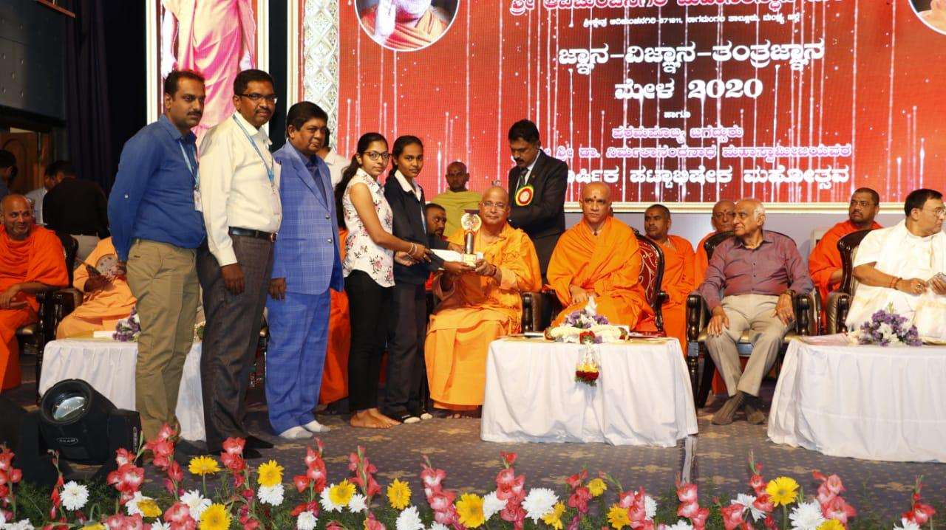
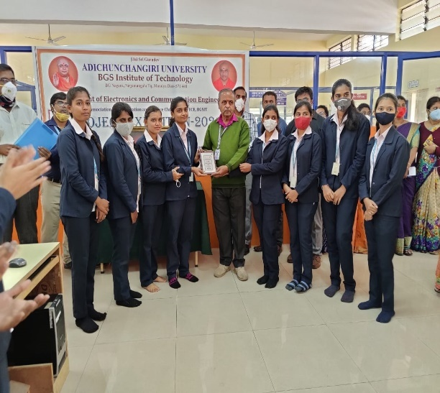
Department Achievements/ Recognitions (Student Level)
ISTE - Best Student Chapter Award
Kushwanth R – 2018
Charith Srinivas - 2019
Students have participated in
  NPTEL Courses
  Hackathons, Ideathons
  TCS Tech Bytes Quiz, code vibes
  Conferences
  Project exhibition like KSCST, JVTM, Anveshana etc.,
  Techfest and online technical events
Students Entrepreneurs – 01
Higher Studies – 07
Placement - 60%
Sl. No | Research Publications (CAY, CAYm1, CAYm2, CAYm3) | No.
1 | Journals (IRJET, JAERD,IRJMET & IRJEMET etc.,) | 83
2 | Conference | 27
Department of Electronics and Communication Engineering

Slide 12
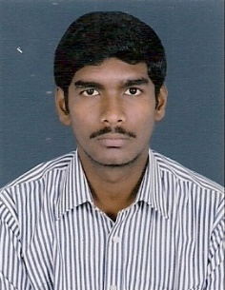
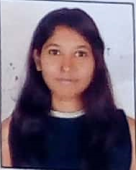
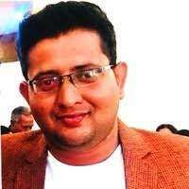
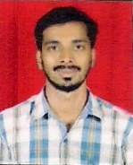
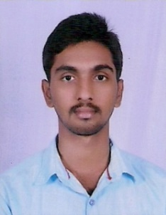
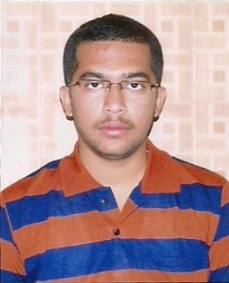


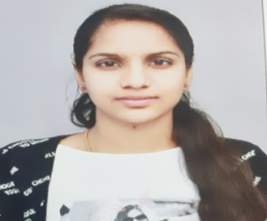
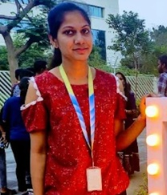
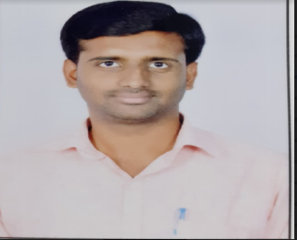
Department Achievements/ Recognitions (Student Level)
MANIKANDAN D. MS, Dublin University, Ireland | PRIYA U. MS, Dublin University Ireland | NISCHAL G. RAO CEO, BLUETEK GROUPS | JAMUNA D.J. Revenue Department, Govt. of Karnataka | ARUN K. VIJAY Manager, State Bank of India | DARSHAN K. L Asst. Engineer, HESCOM
RUTHVIK BHARGAV Officer, Canara Bank | SHRAVANTH D. Managing Director, MVS Group, Bengaluru | PRIYA UMESH PRODUCT DEVELOPMENT ENGINEER - INTEL | SUCHARITHA B S PROGRAM ANALYST COGNIZANT TECHNOLOGY SOLUTION | ARPITHA J SENIOR SOFTWARE ENGINEER CAPGEMINI | VINAYKUMAR H S ASSISTANT PROFESSOR PES COLLEGE OF ENGINEERING MANDYA
Alumni of the Department
Department of Electronics and Communication Engineering

Slide 13
Criterion 1 - Vision, Mission and PEOs
Inline of Institute and Department, Vision and Mission statements
Vision Statements | Institute | Department
 | BGSIT is committed to the cause of creating tomorrow's engineers by providing quality education and inculcating ethical values | To develop high quality engineers with technical knowledge, skills and ethics in the area of Electronics and Communication Engineering to meet industrial and societal needs.
Mission Statements | Institute | Department
 | M1: Imparting quality technical education by nurturing a conducive learning environment. M2: Offering profession training to meet industry requirements. M3: Providing education with a moral culture based and spiritual touch | M1: To provide high quality technical education with up-to-date infrastructure and trained human resources to deliver the curriculum effectively in order to impart technical knowledge and skills. M2: To train the students with entrepreneurship qualities, multidisciplinary knowledge and latest skill sets as required for industry, competitive examinations, higher studies and research activities. M3: To mould the students into professionally-ethical and socially- responsible engineers of high character, team spirit and leadership qualities.
Department of Electronics and Communication Engineering
12

Slide 14
Criterion 1 - Vision, Mission and PEOs
Program Educational Objectives (PEOs)
After 3 to 5 years of graduation, the students will be able to
Engage in industrial, teaching or any technical profession and pursue higher studies and research.
Apply the knowledge of mathematics, science as well as electronics and communication engineering to solve social engineering problems.
Understand, analyze, design and create novel products and solutions.
Display professional and leadership qualities, communication skills, team spirit, multidisciplinary traits and lifelong learning aptitude.
Department of Electronics and Communication Engineering
13

Slide 15
Criterion 1 - Vision, Mission and PEOs
Dissemination
Stakeholders | Published at | Dissemination Method
Internal Stakeholder (Management, Principal, HOD, Faculty, Students, Non-Teaching Staff) | Institute Website (www.bgsit.ac.in ) Department News letter Department Notice boards Classrooms Department Laboratories Department Library HOD Chamber Faculty Chambers Lab Manuals | Orientation Programs Department Meetings Workshops Seminars Progress Reports Conferences Faculty Development Programs Training Programs E-mails
External Stakeholder (Parents, Alumni, Professional Bodies, Industry) | Institute Website (www.bgsit.ac.in ) News letter | Parent-Teachers Meetings Progress Reports Alumni Interactions E-mails
Department of Electronics and Communication Engineering
14

Slide 16
Criterion 2 - Program Curriculum and Teaching Learning Process
2015 Scheme
Sl. No. | Course Group | No.
1 | Basic Science Courses (BS) | 8
2 | Engineering Science Courses (ES) | 8
3 | Humanities | 5
4 | Core Courses (CC) | 32
5 | Professional Elective Courses (PEC) | 5
6 | Open Elective Courses (OEC) | 2
7 | Internship (INT) | 1
8 | Seminar (SEM) | 1
9 | Project Work (PW) | 2
Total No. of Courses | 64
Department of Electronics and Communication Engineering
15

Slide 17
Criterion 2 - Program Curriculum and Teaching Learning Process
GAP Analysis
CO-PO/PSO Mapping with the Levels of 1 , 2 , 3 for individual courses
Average mapping strength of individual PO/PSO for individual course
Consolidated CO-PO/PSO mapping table for courses
Document the total number of courses (N)
Compute the sum of mapping strength for each PO/PSO(S)
P = (S/N*3) *100
Yes
No Gap
P>=Threshold
No
University Curriculum is not address for attaining Particular PO/PSO
Feedback from students
Feedback from Alumni
Feedback from Employer
Suggestions from Faculty
The obtained articulation matrix Consisting of Courses and activities is forwarded to PAC to fulfil the GAP
Department of Electronics and Communication Engineering
16

Slide 18
Criterion 2 - Program Curriculum and Teaching Learning Process
Bridging the Gap in the Curriculum
Through: Project Based Learning Technical talks by renowned Industrialists / Academician Content Beyond Syllabus through Seminars, Workshops, Industrial Visits, Skill Development Program, Conferences, Professional bodies events Students are encouraged to undergo summer Training/ Industrial Training conducted by the department
Department of Electronics and Communication Engineering
17

Slide 19
Criterion 2 - Program Curriculum and Teaching Learning Process
Adherence to Academic Calendar
Instructional Methods and Pedagogical Initiatives
Teaching and Learning Process
Identification of Slow Learners & Bright Students
Proctoring
Department of Electronics and Communication Engineering
18

Slide 20
Criterion 2 - Program Curriculum and Teaching Learning Process
All Class Rooms are fitted with black board and Multimedia Projector.
Lecture methods & Interactive Learning
Board work, PPT, Audio/Video, Seminar, Group Discussion
Computer assisted learning
Internet facilities with Wi-Fi ,teaching tools.
Instructional Methods and Pedagogical Initiatives
Project based learning
Mini Projects and Projects
All Labs are well equipped as per curriculum.
Laboratory learning
Well equipped Labs and open ended experiments
Department of Electronics and Communication Engineering
19

Slide 21
Criterion 2 - Program Curriculum and Teaching Learning Process
Slow Learners | Bright Students
Failed in More than 2 Subjects in SEE Performance in CIE Test 1 and Test 2 ≤ 40% Identified by course teacher and Proctor Action Taken Special classes are arranged for respective courses. Counselled by Proctor and interact with their parents. Regular monitoring and observing them during TLP. | Identified top 5 students in SEE Recommended by proctors Identified from their participation in classroom discussions. Action Taken Additional book are provided by department and central library. Encouraged to do real time projects and to publish papers in reputed journals and conferences. Encourage to do online certification courses. Encouraged to participate in technical events like Hackathon, Project Exhibition etc.,
Department of Electronics and Communication Engineering
20

Slide 22
Criterion 3 - Program Outcomes and Course Outcomes
Program Specific Outcomes (PSOs)
PSO 1: To apply the knowledge of electronics and communication engineering as well as automation tools to create electronic circuits, systems and solutions.
PSO 2: To collaborate effectively with electronics and information technology industries through internship, induction, technical seminar, technical project, research, product design and development, industrial visit, staff training in order to provide the actual industrial exposure to students and faculties.
Department of Electronics and Communication Engineering
21

Slide 23
Criterion 3 - Program Outcomes and Course Outcomes
Process to define the Course Outcomes
Assessment Tools for Attainment of COs
Allotment of Courses
Course Outcome Attainment
Framing CO’s by considering University Curriculum through Brain Storming Session
At the Beginning of semester for all Courses
Direct Assessment (90%)
Indirect Assessment (10%)
Mapping of CO’s with PO’s
Course Delivery Methods and defining assessment tools
CIE (60%)
SEE (30%)
Course End Survey (10%)
Setting Attainment Target Levels (CIE & SEE)
Department of Electronics and Communication Engineering
22

Slide 24
Criterion 3 - Program Outcomes and Course Outcomes
University Course curriculum
Direct Assessment Tools
1 | Test
2 | Assignment
3 | Lab record evaluation
4 | Lab test evaluation
5 | Project Work
6 | Technical seminar
7 | Internship
8 | Semester End Exam
Indirect Assessment Tool
1 | Course End Survey
Course Articulation Matrix
(CO v/s PO’s & PSO’s)
Mapping of COs to test Questions
Direct Assessment (90%)
Student Scores from Tests and Assignment
Attainment calculation for CIE
60% of weightage for CIE
30% of weightage for SEE
CO Attainment
Indirect Assessment (10%)
Total Assessment (100%)
Department of Electronics and Communication Engineering
23

Slide 25
Criterion 3 - Program Outcomes and Course Outcomes
COURSE OUTCOMES: After successful completion of the course, the student will be able to:
Course Outcome | Subject: Digital Signal Processing Code: 17EC52 Semester: 5th Sem
CO 1 | Apply mathematical knowledge to understand DFT, FFT, Basic Filters (Butterworth, Chebyshev) and Realization of Structures of FIR & IIR Filter.
CO 2 | Analyze discrete systems using DFT, FFT and filtering formulation.
CO 3 | Design the IIR filters using Impulse invariance and Bilinear transformation method for given specifications.
CO 4 | Design the FIR filters using Rectangular, Hamming, Hanning and Bartlett window techniques.
CO 5 | Implement digital filters in a variety of forms:-Direct form I& II, Parallel, Cascade and lattice structure.
CO/PO | PO1 | PO2 | PO3 | PO4 | PO5 | PO6 | PO7 | PO8 | PO9 | PO10 | PO11 | PO12 | PSO1 | PSO2
CO 1 | 3 | - | - | - | - | - | - | - | - | - | - | - | 2 | -
CO 2 | 3 | 3 | - | - | - | - | - | - | - | - | - | - | 2 | -
CO 3 | 3 | 3 | 2 | - | - | - | - | - | - | - | - | - | 2 | -
CO 4 | 3 | 3 | 2 | - | - | - | - | - | - | - | - | - | 2 | -
CO 5 | 3 | 3 | 3 | - | - | - | - | - | - | - | - | - | 3 | -
Average | 3 | 3 | 2.33 | - | - | - | - | - | - | - | - | - | 2.2 | -
Mapping of COs with POs and PSOs (Articulation Matrix)
Level:
3 - High
2 - Moderate
1 - Low
Department of Electronics and Communication Engineering
24

Slide 26
Criterion 3 - Program Outcomes and Course Outcomes
Sl. No | Assessment Method | Max. Marks | Course Outcome
 |  |  | Attainment Target Levels
1 | Continuous Internal Evaluation (CIE) | 15(Test) + 5(Assignment) | For theory courses: ≥70% - Target3 >60% and <70% - Target 2 >50% and <60% - Target 1 | For assignment: ≥90% - Target3 >80% and <90% - Target 2 >70% and <80% - Target 1
2 | Lab Internal Assessment | 20 | Lab Internal Assessment :≥80% - Target3 >70% and <80% - Target 2 >60% and <70% - Target 1
3 | Semester End Examination (SEE) | 80 (Theory Exam) | For theory Exam : ≥70% - Target3 >60% and <70% - Target 2 >50% and <60% - Target 1
 |  | 80 (Lab Exam) | For Lab Exam: ≥80% - Target3 >70% and <80% - Target 2 >60% and <70% - Target 1
4 | Project Work Phase - I Project Work (Internal) | 100(Int) | ≥80% - Target3 >70% and <80% - Target 2 >60% and <70% - Target 1
5 | Internship/ Professional Practice (Internal and External) | 50(Int)+50(Ext) | ≥80% - Target3 >70% and <80% - Target 2 >60% and <70% - Target 1
6 | Seminar | 100 | ≥80% - Target3 >70% and <80% - Target 2 >60% and <70% - Target 1
Department of Electronics and Communication Engineering
25

Slide 27
Criterion 3 - Program Outcomes and Course Outcomes
Department of Electronics and Communication Engineering
26

Slide 28
Criterion 3 - Program Outcomes and Course Outcomes
SEE Threshold Values
≥70%=3
≥60<70%=2
≥50<60%=1
<50%=0
CIE = (0.9*IA)+(0.1*Assignment)
Department of Electronics and Communication Engineering
27

Slide 29
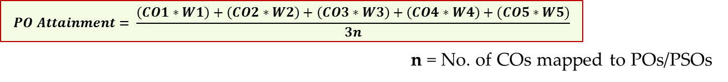
Criterion 3 - Program Outcomes and Course Outcomes
CO Attainment
$$CO Attainment=(60\% ∗CIE)+(30\% ∗SEE)+(10\% ∗ CES)$$
PO Attainment
Weighted Sum = (CO1*W1)+(CO2*W2)+(CO3*W3)+(CO4*W4)+(CO5*W5)
Department of Electronics and Communication Engineering
28

Slide 30
Criterion 3 - Program Outcomes and Course Outcomes
Direct Assessment
Direct method | Form of assessment | Frequency of assessment
CO Attainment | 1. Test | Three Times/Semester
 | 2. Assignment | Three Times/Semester
 | 3. Lab record evaluation | Once /week
 | 4. Lab test evaluation | Once /semester
 | 5. Seminar | Once in a Year
 | 6. Project Work | Once in a Year
 | 7. Internship | Once in a Year
 | 8. Semester End Exams | Once in a semester
Indirect Assessment
Indirect method | Form of Assessment |  | Frequency of assessment
Program Exit Survey | Survey Questionnaire |  | End of the Programme
Department of Electronics and Communication Engineering
29

Slide 31
Criterion 3 - Program Outcomes and Course Outcomes
POs & PSOs Attainments
$$Final Attainment=80\% \left(Direct Assesment\right)+20\%(Indirect Assesment)$$
Course | PO1 | PO2 | PO3 | PO4 | PO5 | PO6 | PO7 | PO8 | PO9 | PO10 | PO11 | PO12 | PSO1 | PSO2
Direct Assessment (DA) | 1.96 | 1.57 | 1.46 | 2.14 | 2.05 | 1.32 | 1.28 | 1.47 | 1.77 | 1.98 | 2.02 | 1.06 | 1.57 | 2.14
Indirect Assessment (IA) | 2.34 | 2.28 | 2.28 | 2.28 | 2.28 | 2.28 | 2.28 | 2.28 | 2.4 | 2.28 | 2.28 | 2.34 | 2.4 | 2.34
Final Attainment = (80% DA +20% IA) | 2.04 | 1.71 | 1.62 | 2.17 | 2.10 | 1.51 | 1.48 | 1.63 | 1.90 | 2.04 | 2.07 | 1.32 | 1.73 | 2.18
Department of Electronics and Communication Engineering
30

Slide 32
Criterion 4 - Students Performance
ENROLLMENT RATIO
Student Enrolment ratio in percentage (Average of CAY, CAYm1, CAYm2)= 96.41%
Department of Electronics and Communication Engineering
31

Slide 33
Criterion 4 - Students Performance
Success Index SI=X/Y
1.For LYG -59/147= 0.4013
2. For LYGM1- 69/143=0.48
3. For LYGM2-57/154=0.37
Average Success Index=0.4171
Average Success Index = 0.4013 (LYG) + 0.48 (LYGm1) + 0.37 (LYGm2) = 0.4171
Success rate without backlog in any year of study = 25*0.4171 = 10.4275
Department of Electronics and Communication Engineering
32

Slide 34
Criterion 4 - Students Performance
Student Graduated in Stipulated Period
CALCULATION
Success Index SI=X/Y
1.For LYG -126/147= 0.86
2. For LYGM1- 124/143=0.87
3. For LYGM2-116/154=0.75
Average Success Index=0.83
Success rate in stipulated period = 15* Average SI= 15*0.83 = 12.45
Department of Electronics and Communication Engineering
33

Slide 35
Criterion 4 - Students Performance
Academic Performance Index
CALCULATION:
API = X*(Y/Z)
For CAYm1 7.3*(115/122 )= 6.88
For CAYm2 6.63*(126/127)= 6.58
For CAYm3 6.86*(124/124)= 6.86
Average API= 6.77
Academic Performance API= 1.5*6.77= 10.16
Department of Electronics and Communication Engineering
34

Slide 36
Criterion 4 - Students Performance
Academic Performance Index
CALCULATION:
API = X*(Y/Z)
For CAYm1 7.71*(116/119 )= 7.52
For CAYm2 6.80*(122/126)= 6.58
For CAYm3 6.5*(127/135)= 6.11
Average API= 6.73
Academic Performance API= 1.5*6.73 = 10.095
Department of Electronics and Communication Engineering
35

Slide 37
Criterion 4 - Students Performance
Placement, Higher Studies and Entrepreneurship
Placement Index: (X+Y+Z)/N
For LYG 56/126= 0.44
For LYGm1 72/124=0.58
For LYGm2 92/118= 0.78
Average Placement= 0.6
Average Placement (For Three Years CAY, CAYm1, CAYm2, CAYm3): 60%
Assessment Points= 40* Average Placement = 40*0.6= 24
Department of Electronics and Communication Engineering
36

Slide 38
Criterion 4 - Students Performance
Students have
  Attended workshops
  Participated in Inter Institute Competitions
  Undergone Internships
  Taken up Technical Events
Organizing Conference, Technical Talks and Workshops.
Student Chapters – IEEE, CAS and IETE.
Participated in Project Exhibition.
Participated in Hackathons.
Participated TCS TechBytes Quiz.
Participated in inter and intra institutions.
Contributed information in Department News Letter – Samvahana (Every 6 Months).
Department of Electronics and Communication Engineering
37

Slide 39


Criterion 4 - Students Performance
Student Chapter and Forum
IEEE, Circuit And System (CAS)Chapter
IETE Student forum.
Department of Electronics and Communication Engineering
38

Slide 40
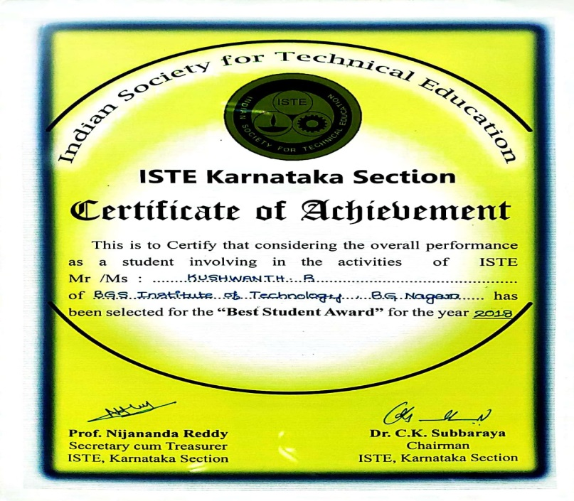
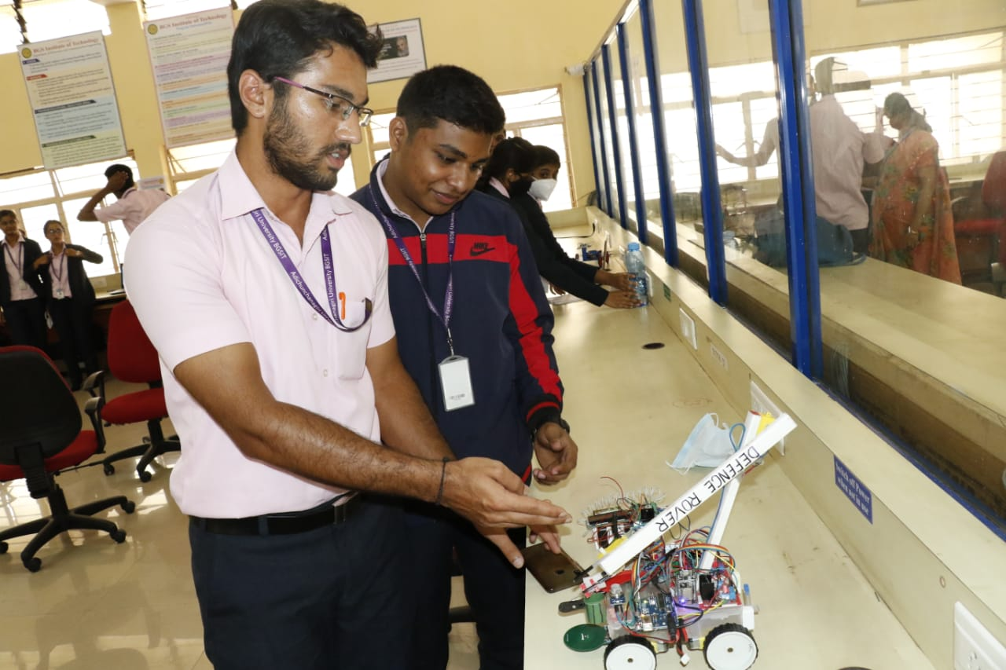
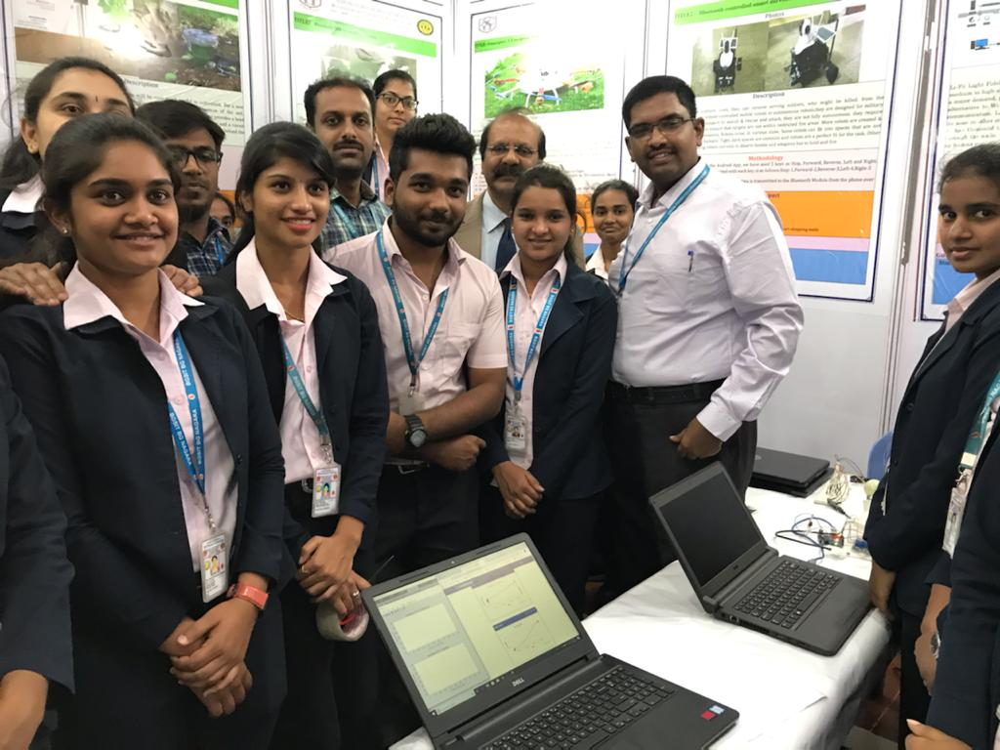
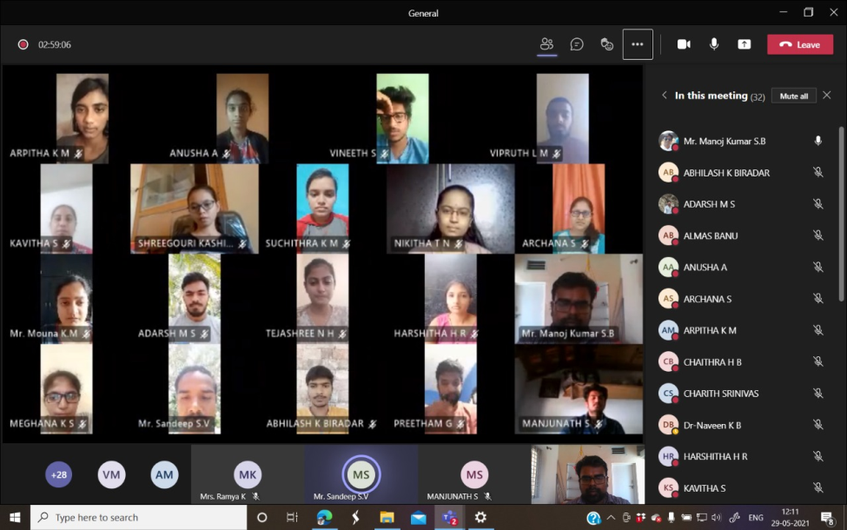
Criterion 4 - Students Performance
Department of Electronics and Communication Engineering
39

Slide 41
Criterion 5 - Faculty Information and Contribution
Sl.No | Faculty Name | Qualification | Designation | Specialization | Date of Joining | Type of association
1 | Dr. K N Muralidhara | M.E., Ph.D (IIT) | Professor & Head | Electronic Devices and Computer Simulation | 26.08.2019 | Regular
2 | Dr. M B Anandaraju | M.E., Ph.D | Professor | Power Electronics | 03.07.2006 | Regular
3 | Dr. Naveen K B | M.Tech., Ph.D | Professor | VLSI Design & Embedded Systems | 02.08.2010 | Regular
4 | Dr. Naveen B | M.Tech., Ph.D | Associate Professor | VLSI Design & Embedded Systems | 09.02.2018 | Regular
5 | Dr. Manoj Kumar S B | M.Tech., Ph.D | Assistant Professor | VLSI Design & Embedded Systems | 19.07.2010 | Regular
6 | Mrs. Prabhavathi K | M.Tech., (Ph.D) | Assistant Professor | Networking and Internet Engineering | 01.08.2007 | Regular
7 | Mrs. Kavitha B C | M.Tech., (Ph.D) | Assistant Professor | Computer Applications and Industrial Drive | 25.07.2012 | Regular
8 | Mr. Mohan Kumar K S | M.Tech., (Ph.D) | Assistant Professor | Digital Communication | 18.07.2011 | Regular
9 | Mr. Balaji B S | B.E., M.Tech | Assistant Professor | VLSI Design & Embedded Systems | 18.07.2011 | Regular
10 | Mrs. Shalini K J | B.E., M.Tech | Assistant Professor | VLSI Design & Embedded Systems | 21.07.2008 | Regular
11 | Mrs. Ramya K | B.E., M.Tech | Assistant Professor | Digital Communication | 26.07.2013 | Regular
12 | Mrs. Kokila K S | B.E., M.Tech | Assistant Professor | VLSI Design & Embedded Systems | 19.01.2015 | Regular
13 | Mrs. Anusha M N | B.E., M.Tech | Assistant Professor | Digital Electronics and Communication Systems | 20.07.2015 | Regular
14 | Mr. Sandeep S V | B.E., M.Tech | Assistant Professor | Digital Communication | 22.08.2016 | Regular
Department of Electronics and Communication Engineering
40

Slide 42
Criterion 5 - Faculty Information and Contribution
Sl.No | Faculty Name | Qualification | Designation | Specialization | Date of Joining | Type of association
15 | Mrs. Nandini S | B.E., M.Tech | Assistant Professor | Digital Communication | 20.01.2016 | Regular
16 | Mrs. Srividya C N | B.E., M.Tech | Assistant Professor | VLSI Design & Embedded Systems | 01.08.2017 | Regular
17 | Mr. Jayanth dwijesh H P | B.E., M.Tech | Assistant Professor | Digital Electronics and Communication Systems | 01.08.2017 | Regular
18 | Mrs. Priyanka R | B.E., M.Tech | Assistant Professor | Digital Electronics and Communication Systems | 18.08.2017 | Regular
19 | Ms. Nischitha S | B.E., M.Tech | Assistant Professor | Signal Processing | 16.08.2017 | Regular
20 | Mrs. Prafulla P S | B.E., M.Tech | Assistant Professor | Digital Communication and Networking | 16.08.2017 | Regular
21 | Ms. Bharathi R | B.E., M.Tech | Assistant Professor | VLSI Design & Embedded Systems | 11.06.2018 | Regular
22 | Mr. Goutham V | M.Tech., (Ph.D) | Assistant Professor | Digital Electronics and Communication Systems | 01.08.2018 | Regular
23 | Mr. Simha D K L N | B.E., M.Tech | Assistant Professor | Digital Electronics and Communication Systems | 30.08.2018 | Regular
24 | Mrs. Hamsashree M K | B.E., M.Tech | Assistant Professor | Information Technology | 21.08.2019 | Regular
25 | Ms. Lakshmi D L | B.E., M.Tech | Assistant Professor | Digital Electronics and Communication Systems | 21.08.2019 | Regular
26 | Ms. Mouna K M | B.E., M.Tech | Assistant Professor | Digital Communication and Networking | 21.08.2019 | Regular
27 | Mrs. Rashmi S | B.E., M.Tech | Assistant Professor | Digital Electronics and Communications | 21.08.2019 | Regular
28 | Mrs. Divyashree R H | B.E., M.Tech | Assistant Professor | Digital Electronics | 03.02.2021 | Regular
Department of Electronics and Communication Engineering
41

Slide 43
Criterion 5 - Faculty Information and Contribution
FACULTY CADRE
Description | CAY (2020-21) | CAY M1 (2019-20) | CAY M2 (2018-19)
Total no. of students in the department. | 412 (total UG+PG) | 439 (total UG+PG) | 467 (total UG+PG)
No. of Faculty in the department | 25 (F1) | 25 (F2) | 22 (F3)
Student faculty ratio(SFR) | 16.48 (SFR1=S1/F1) | 17.56 (SFR2=S2/F2) | 21.22 (SFR3=S3/F3)
Average SFR | 18.42 (SFR= (SFR1+SFR2+SFR3)/3)
F=Total number of Faculty Members in the department(excluding first year faculty)
Years | Professor | Assoc. Professor | Asst. Professor
2020-21 | 2 | 2 | 24
2019-20 | 2 | 2 | 24
2018-19 | 1 | 2 | 22
2017-18 | 1 | 0 | 25
FACULTY QUALIFICATIONS
Years | Ph.D. | M. Tech
2020-21 | 4 | 24
2019-20 | 4 | 24
2018-19 | 3 | 22
2017-18 | 1 | 25
Department of Electronics and Communication Engineering
42

Slide 44
Criterion 5 - Faculty Information and Contribution
FACULTY RETENTION
Years | No. of Faculty Retained
2020-21 | 21 (84%)
2019-20 | 23 (92%)
2018-19 | 25 (Base Year)
Average Retention – 88%
Technical Events/FDP Attended
Faculty Publications
Years | No. of FDPs attended by faculty members
2020-21 | 122
2019-20 | 52
2018-19 | 19
2017-18 | 28
Years | Publications
2020-21 | 39
2019-20 | 12
2018-19 | 47
2017-18 | 43
Department of Electronics and Communication Engineering
43

Slide 45
Criterion 5 - Faculty Information and Contribution
Patents Filed
Sl.No | Applicant Name | Ref. No/ Application No. | Date of filing | Title of Invention | National/ International
1 | Dr. Naveen K B | 202041029775 A | 13/07/2020 | Smart Kitchen Using Altering System and IOT | National
2 | Dr. M B Anandaraju Dr. Naveen K B Dr. Naveen B | 17015220 | 09.09.2020 | Method of auto tuning PID controller using evolutionary computational technique | International (USA)
3 | Dr. Naveen K B Dr. M B Anandaraju Dr. Naveen B | 17015232 | 09.09.2020 | Method of lung cancer detection by using deep learning technique | International (USA)
4 | Dr. Naveen B Dr. Naveen K B Dr. M B Anandaraju | 202041038831 | 09.09.2020 | Content based image retrieval for ECG reports using data analytics | National
5 | Dr. Naveen B Dr. Naveen K B Dr. M B Anandaraju | 202041038832 | 09.09.2020 | Method for detection & localization of dental caries using deep learning | National
Department of Electronics and Communication Engineering
44

Slide 46
Criterion 5 - Faculty Information and Contribution
Sl.No | Applicant Name | Ref. No/ Application No. | Date of filing | Title of Invention | National/ International
6 | Dr.Naveen B | 202041029920 | 11.07.2020 | A Single window documentation procedure for multiple assessment and appraisal requirents | National
7 | Dr. Naveen K B Manoj Kumar S B | 202141002572 | 20/01/2021 | Motorcycle Pitch With Non-Linear Control And Accident-Avoidance System Using IOT | National
8 | Manoj Kumar S B | 202141017421 | 14/04/2021 | Women Safety using Intelligence of Things. All details will be shared once it is published. | National
9 | Mr. Manoj Kumar S B | 202141035429 A | 13.08.2021 | Machine Learning and IOT Based Automated Health evaluation using medical images | National
Department of Electronics and Communication Engineering
45

Slide 47
Criterion 5 - Faculty Information and Contribution
Modern Teaching Aid
Models/Kit Demonstration
Innovation by Faculty in Teaching and Learning
Charts
Videos
E-Learning
Flipped Class
Technical Activities
Project Based Learning
Department of Electronics and Communication Engineering
46

Slide 48
Criterion - Facilities and Technical Support
Sl. No. | Description | Numbers | Area in (Sq. Mts.)
1. | Class Rooms | UG – 06 PG-02 | 106.83 46
2. | Seminar hall | 01 | 232.25
3. | HoD Room | 01 | 31.6
4. | Professor Room | 01 | 14.5
5. | Faculty Rooms | 11 | 36.23 12.5 21.36
6. | Department library | 01 | 55.8
7. | Project | 01 | 92
8. | R&D Lab | 01 | 123
Sl. No. | Laboratory | Space (Sq. Mts.)
1. | Basic Electrical Lab | 93
2. | Analog Electronics/ Linear ICs & Communication Lab | 92
3. | Digital Electronics Lab | 92
4. | Microcontroller/ HDL Lab | 78.5
5. | Advanced Communication Lab | 88.2
6. | DSP Lab/ AI &ML Lab | 78.9
7. | Embedded System Lab/ CCN Lab | 91.9
8. | VLSI Lab | 92.9
Department of Electronics and Communication Engineering
47

Slide 49
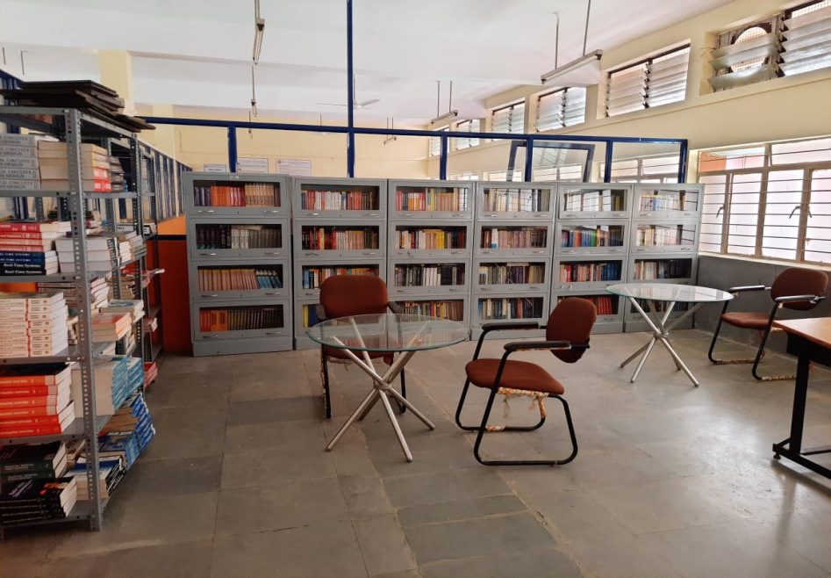

Criterion 6 - Facilities and Technical Support
Sl. No. | Software
1 | Xilinx Vivado design suite
2 | Cadence (Industry Standard) v 6.1.7
3 | Tanner EDA Tool Version 13.1
4 | Keil Micro Vision V4, Proteus 8.1
5 | MatLab 2014 A, CC Studio V3.1
Sl.No. | Hardware
1 | Digital Storage Oscilloscope (DSO)
2 | Analog CRO
3 | Function Generator/Signal Generator
4 | Power Supply and Measuring Instruments
5 | ARM Controller Boards
6 | Artix 7 FPGA Boards
7 | Optical Communication Kit
Sl. No. | Journal/ Library Resource
1 | VTU e-Consortium Journals
2 | Electronic Magazines
3 | Elsevier/ Science Direct
4 | Taylor & Francis
5 | Knimbus
Department of Electronics and Communication Engineering
48

Slide 50
Criterion - Facilities and Technical Support
Non-Teaching Staff
Foreman | 01
Sl.No | Staff Name | Qualification | Designation
1 | Mr. Sathish S N | B.E., | Foreman
2 | Ms. Niveditha | B.E., | Instructor
3 | Mr. Nanjundegowda K S | ITI., Dip | Instructor
4 | Mr. Rajesh N L | ITI., Dip | Instructor
5 | Mr. Indu Kumar R S | ITI., Dip | Instructor
6 | Mrs. Kusuma R K | Dip | Instructor
7 | Ms. Chandana S | Dip | Instructor
8 | Mr. Ganesha S S | ITI | Asst. Instructor
9 | Mr. Ashok K | SSLC | Asst. Instructor
10 | Mr. Girisha G N | SSLC., (ITI) | Attender
11 | Mr. Ravikumar G K | 7th Std | Peon
12 | Mrs. Thayamma | -- | Peon
Instructors | 06
Asst. Instructors | 02
Attender | 01
Peon | 02
Total | 12
Qualification | Total in No.
B.E | 2
Diploma | 5
SSLC & ITI | 3
Department of Electronics and Communication Engineering
49

Slide 51
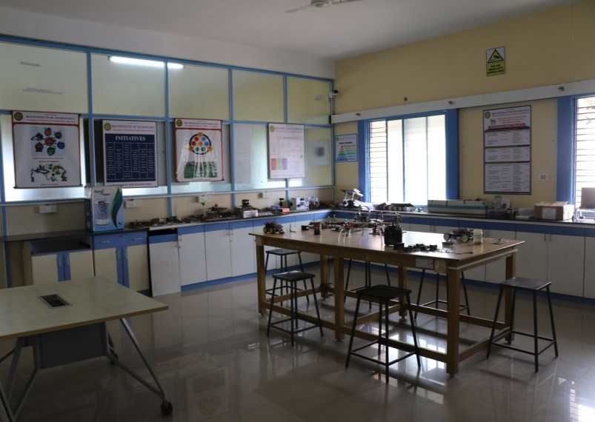
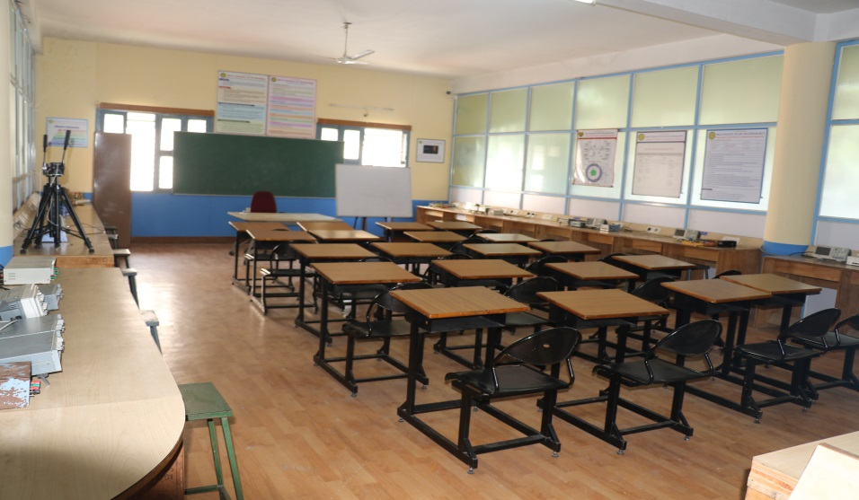

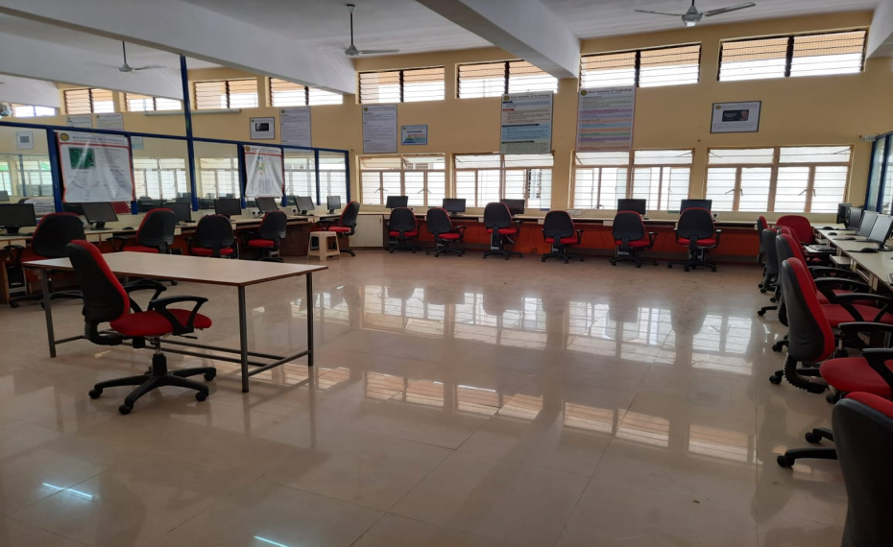
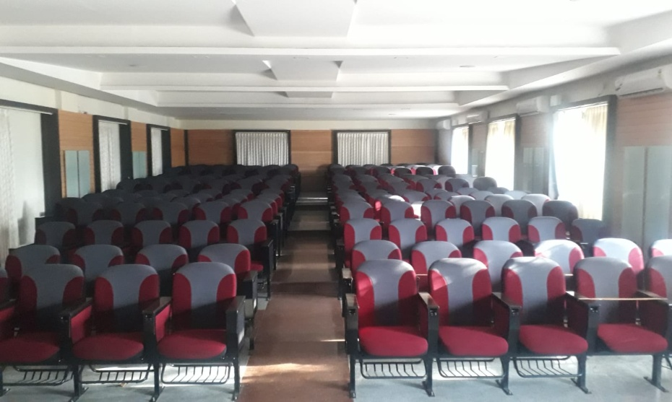
Criterion - Facilities and Technical Support
Project Lab
System Lab
Department Library
Circuit Lab
Seminar Hall
Department of Electronics and Communication Engineering
50

Slide 52
Criterion 7 - Continuous Improvement
POs & PSOs Attainment Levels and Actions for Improvement
POs / PSOs | Target Level (%) | Attainment Level (%) | Observations
PO1.Engineering Knowledge: Apply the knowledge of mathematics, science, engineering fundamentals, and an engineering specialization to the solution of complex engineering problems.
PO1 | 80 | 71.6 | Target is not achieved Attainment level for the courses 15EC34, 15EC33, 15EC32, 15EC44, 15EC46, 15EC53 are lower than the target level.
ACTION1: Basic concepts and numerical problems will be discussed in regular classes and also in tutorial classes. ACTION 2: Students are motivated to read reference books.
Department of Electronics and Communication Engineering
51

Slide 53
Criterion 7 - Continuous Improvement
Internal
External
Internal Audit by Auditing Committee
Local Inspection Committee (LIC) from VTU
Review of Academic Documents
Principal
All departments
Observation by Auditors
Review of Academic Documents
Any deviations
Yes
Follow-up Audit
Non-Compliance report if deficiency
No
Continuation of affiliation
Report Send to Principal
Department of Electronics and Communication Engineering
52

Slide 54
Criterion 7 - Continuous Improvement
Placement, Higher Studies, Entrepreneurs
CET Rank Details
Diploma CET Rank Details
Department of Electronics and Communication Engineering
53

Slide 55
Outcome Based Education
Outcomes based education (OBE) is a process that involves the restructuring of curriculum, assessment and reporting practices in education to reflect the achievement of high order learning and mastery rather than the accumulation of course credits”
  Benefits of OBE:
  More directed & coherent curriculum.
  Graduates will be more “relevant” to industry & other stakeholders
  Continuous Quality Improvement (CQI) is in place.
Department of Electronics and Communication Engineering
54

Slide 56
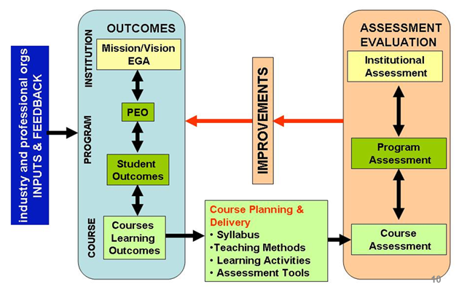
Outcome Based Education
OBE Framework
Stake Holder Inputs & Feedback
Vision/Mission
Department of Electronics and Communication Engineering
55

Slide 57
Outcome Based Education
OBE Measuring Process
Program & Course Outcomes
Program Educational Objectives
Input
Process
Teaching Staff
Curriculum
Labs
Other Resource
Teaching &
Learning
Students at
Graduation
Graduates
to Fulfill
Stakeholders’
Satisfaction
Assessment by exam, test and assignments.
Assessment of teaching staff, lecture material & flow, results and student ‘capabilities’ (Short & long-term outcomes), lab interview, exit survey etc.
More ‘thinking’ projects, with analysis.
Feedback from industry, alumni and other stakeholders.
Clear continuous improvement step.
Stakeholders
Department of Electronics and Communication Engineering
56

Slide 58
Outcome Based Education
Approach of OBE
Identifying Desired Outcomes
Determining assessment measures for the achievements of Outcomes
Deciding on strategies and methodologies to achieve those outcomes
Department of Electronics and Communication Engineering
57

Slide 59
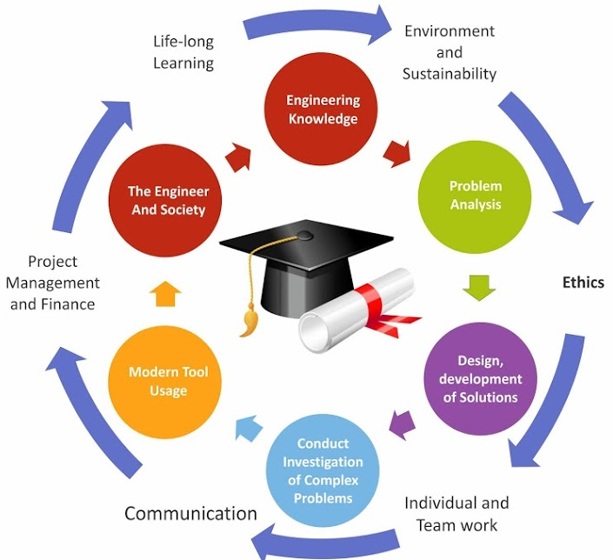
Outcome Based Education
Graduate Attributes
Department of Electronics and Communication Engineering
58

Slide 60
Outcome Based Education
OBE
(Education)
What the student should be able to do?
OBE
(Curriculum)
How to make the student achieve the outcome?
OBE
(Teaching and Learning)
How to measure what the student has achieved?
OBE
(Assessment)
Department of Electronics and Communication Engineering
59

Slide 61
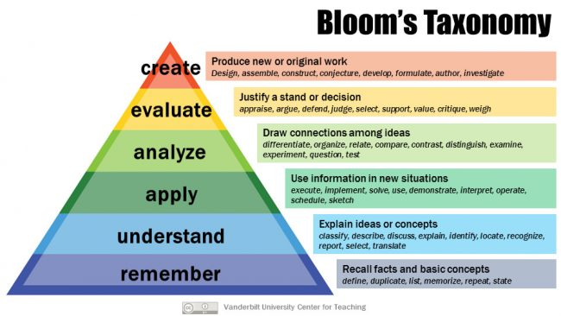
Outcome Based Education
Department of Electronics and Communication Engineering
60

Slide 62
Outcome Based Education
Students Under OBE
Students are expected to be able to do more challenging tasks other than memorize and reproduce what was taught.
Students should be able to: write project proposals, complete projects, analyze case studies, give case presentations, show their abilities to think, question, research, and make decisions based on the findings.
Be more Creative, able to analyze and Synthesize information.
Able to plan and organize tasks, able to work in team as a community to propose solutions to problems and market their solutions
Department of Electronics and Communication Engineering
61

Slide 63
Outcome Based Education
Administration System for Implementation of OBE
Course Teacher
Module Co-ordinator
Programme Coordinator
Programme Assessment Committee
Department Advisory Board
Internal Quality Assurance Cell (IQAC)
Department of Electronics and Communication Engineering
62

Slide 64
Outcome Based Education
Process for defining department Vision and Mission statements
Established Standards
BGSIT
Vision and Mission Statements
SWOT Analysis
Inputs from HOD and Faculties
Department
Vision and Mission Statements Prepared By HOD
Stakeholders Inputs
PAC reviews the draft of Department Vision and Mission Statements
Not Approved
(Incorporate Suggestion)
Review of Vision and Mission by DAB for Approval
Approved
Approval by Head of the Institution
Publishing, Dissemination and Awareness of Department Vision and Mission statements to all the Stakeholders
Department of Electronics and Communication Engineering
63

Slide 65
Outcome Based Education
Process for defining Program Educational Objectives (PEOs)
Vision and Mission of the Institution
Draft of Program Educational Objectives (PEOs) prepared by HOD
Program Outcomes
Vision and Mission of the Department
SWOT Analysis
Stakeholders Input
Review and Refining of PEOs by PAC
Review of PEOs by DAB for Approval
Not Approved
(Incorporate Suggestion)
Approved
Finalize PEOs
Approval by
Head of the Institution
Publishing, Dissemination and Awareness of PEOs
to all the stake holders.
Department of Electronics and Communication Engineering
64

Slide 66
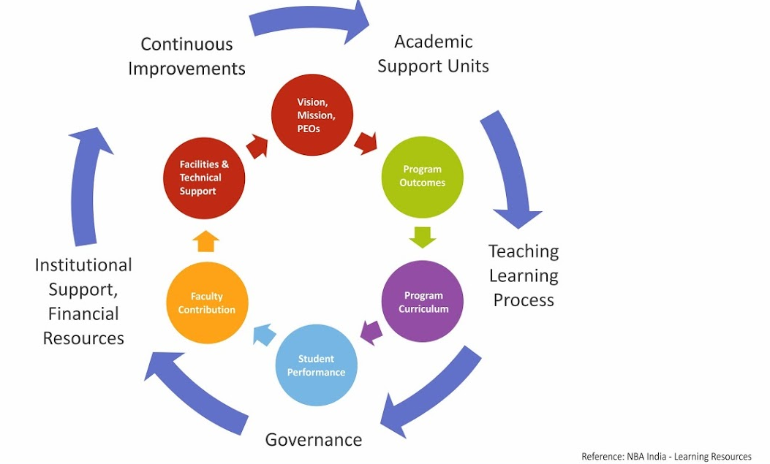
Outcome Based Education
Quality Assurance
Department of Electronics and Communication Engineering
65

Slide 67
Outcome Based Education
Continuous Quality Improvement (CQI)
Assessment
Assessment
Assessment
Analysis
Analysis
Analysis
Stakeholders’
Mission & Vision
Program Educational Objectives
Program Outcomes
Course Outcomes
CQI
CQI
CQI
Department of Electronics and Communication Engineering
66

Slide 68
Outcome Based Education
Concept Map
University Curriculum
Course Assigned To Course Teacher
Course Outcomes
Preparing Test Schedule As Per The Academic Calendar
Blooms Taxonomy Levels
Syllabus Coverage
Question Paper Setting With Scheme Of Evaluation
Equal Marks Distribution To COs
Mapping With Relevant COs
Question Paper Review by Module Coordinator
Complexity Of The Question paper
No
Evaluation As Per The Scheme
Approved By HOD
Yes
Blue Books/ Answer Scripts Shown to Students
Process of conduction and Evaluation of Test Papers
Submit The Question Papers To Test Coordinators
Marks Sheet Submission To Test Co-ordinators
Conduction of Test
Department of Electronics and Communication Engineering
67

Slide 69
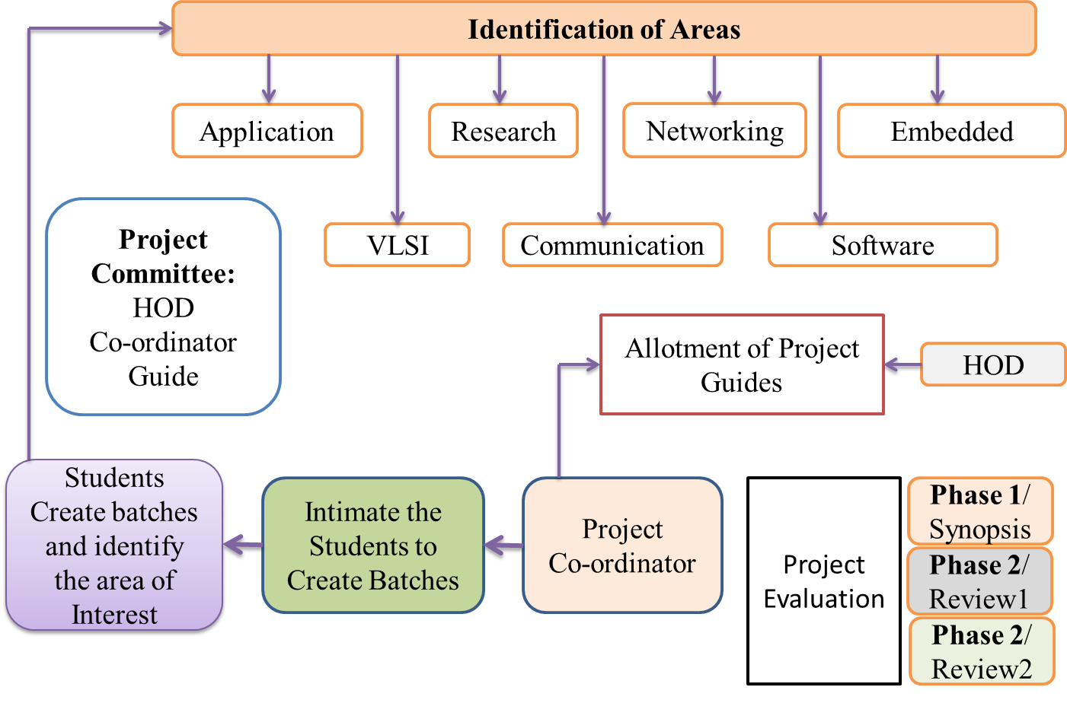
Outcome Based Education
Problem Analysed for Project Work in OBE
Literature
Lectures
Group Studies
Problem Analysis
Problem Solving
Report
Tutorials
Field Work
Experiment
Department of Electronics and Communication Engineering
68

Slide 70
Outcome Based Education
Project Allocation Process
HOD nominates the Project Coordinator
Identification of projects and allocation methodology for Students and Faculty
Students are
Allowed to form group/batch consisting of 2 to 4 members
Instructed to do the Projects based on their interest
Advised from Project guides to avoid duplication of projects
Informed to submit the proposed project title and synopsis to project coordinator
Faculties
Help the students to form group/batch consisting of 2 to 4 members
Instructs the students to do projects based on their interest
Advice the students to avoid duplication of projects
Help their project batch students to submit the proposed project title and synopsis to project coordinator
Project coordinator and HOD identifies the project based on defined area
The HOD and the project coordinator allot project guides based on the student’s interest, Project Domain and the faculty specialization
Evaluation of project work in three phases according to the rubrics
The project committee consists of HOD, guide and project coordinator awards final marks to the students based on the evaluation of project in different phases
Department of Electronics and Communication Engineering
69

Slide 71
Outcome Based Education
Best Practices in Department
Curriculum Gap Analysis and Planning, students’ project work will be reviewed periodically
Tutorial and Remedial Classes are conducted
Student Performances are monitored and analysed regularly through Proctoring System
Student Centric Activities are done regularly
Content Beyond Syllabus through Seminars, Flipped class, Project based learning, Workshops, Technical Talks, Industrial Visits, Regular aptitude and communication skill training are conducted.
Student Feedback System (Mid of the Semester – Offline and
End of the Semester – Online) is followed
Department of Electronics and Communication Engineering
70

Slide 72
Outcome Based Education
Best Practices in Department
MOUs with industries are executed and activities are conducted
Student Co-curricular and extra curricular activities are encouraged
Encouraging Bright Students in the Department
Peer Review of Teaching
Counselling for Faculty Members
Entrepreneurship Development Cell
Department of Electronics and Communication Engineering
71

Slide 73
Outcome Based Education
Faculty Performance Appraisal and Development System (FPADS)
Faculty fills the appraisal form for one academic year and undergoes self-evaluation
HOD reviews the self-appraisal forms and gives his opinion by assigning the marks
After HOD review, HOD will forward the same to the head of the institution
Head of the institution will form the committee for further review
Committee members evaluate and verify the documents submitted by the faculty
Principal takes the final decision in consultation with HOD in recommendation faculty award/promotion/ increment/rectification/lay-off
Recommended to undergo Training Programs
Overall Rating
≥ 85%
Letter of Appreciation
Overall Rating
≤ 59%
Recommended for faculty Awards
HOD Suggests action plan to the faculty member
Department of Electronics and Communication Engineering
72

Slide 74
Outcome Based Education
Conclusion of OBE in ECE Department
OBE is a student focus and Improved learning process.
That change will require learning opportunities for teachers that reinforce and expand their knowledge
Increased in institutional effectiveness
Enhanced accountability in Teaching and Learning process
Quality education
Develop measurable & linked
  Program/course learning outcomes
  Program Educational Objectives
  Assessment & Evaluation
Teachers' Learning will be a valuable resource for classrooms, departments, and professional organizations.
Department of Electronics and Communication Engineering
73

Slide 75
On behalf
of
Our Students
Staff, Principal & Management
Thank You
Department of Electronics and Communication Engineering

